Slide 1

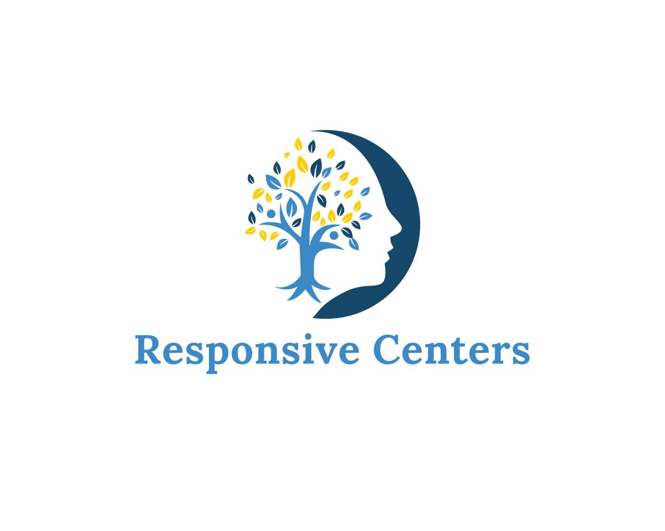
An overview
RESPONSIVE CENTERS +
INTEGRATED PSYCHIATRIC CONSULTANTS (IPC)
KRYSTAL SPEIER, LCPC
CLINICAL DIRECTOR AT RESPONSIVE CENTERS

Slide 2




Responsive Centers
PRIVATE PRACTICE
SERVING THE KANSAS CITY COMMUNITY FOR 40+ YEARS
Responsive Centers provides services to children, adolescents, adults, couples, and families in a caring and supportive environment.

Slide 3

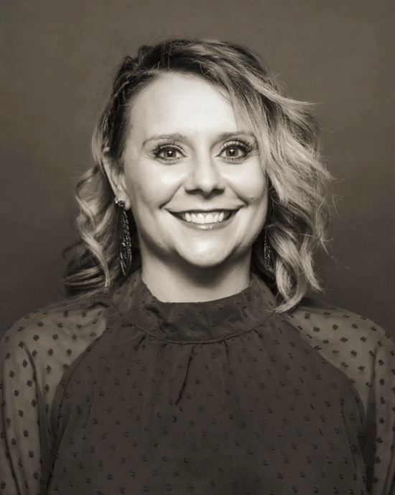
Krystal Speier, LCPC
CLINICAL DIRECTOR
Krystal’s passion has always been with helping others and supporting families through difficult times while helping them find the light in the darkness. She has a long history of working with a variety of clients, having spent years working in psychiatric hospitals for children and adults and assisting families in the foster care system.
She actively works as a team player with her clients to help them discover solutions to the issues they experience. She specializes in working with trauma and abuse, PTSD, children, adolescents, and adults. The treatment modalities she primarily works with are CBT and Trauma Systems Therapy.
As Clinical Director, Krystal brings knowledge of the ins-and-outs of private practice. In 2020, she became a Board-Approved Clinical Supervisor. In addition to her direct client care services, Krystal has a history of developing and presenting training sessions on trauma-informed care and working as the lead member of a team challenged to implement Positive Behavior Interventions and Supports (PBIS) within a system of care.
Notes:
Krystal’s passion has always been with helping others and has a long history of supporting families through difficult times while helping them find the light in the darkness of the difficulty. She prides herself in being able to understand others’ needs, whether it be couples, individuals, adolescents, or the whole family to experience the most this life has to offer.
She actively works as a team player with her clients to help them discover solutions to the issues they experience. She specializes in working with trauma and abuse, PTSD, children, adolescents, and adults. The treatment modalities she primarily works with are CBT and Trauma Systems Therapy.
Krystal graduated from Fort Hays State University with a BS in Psychology and went on to get her MS in Community Counseling. She has a long history of working with a variety of clients, having spent years working in psychiatric hospitals for children and Psychiatric Residential Treatment Facility (PRTF) with children and their families. She has worked with children and families in the foster care system to assist in achieving permanency in the home or getting back into the biological home. Krystal has engaged in individual, group, family, and couples therapy. She obtained her clinical license in September of 2014 and became a nationally certified counselor in 2017.
In 2020, Krystal became a Board-Approved Clinical Supervisor. She is currently licensed in the state of Kansas, Missouri and Texas as a Licensed Clinical Professional Counselor. In addition to her direct client care services, Krystal has a history of developing and presenting training sessions on trauma-informed care and working as the lead member of a team challenged to implement Positive Behavior Interventions and Supports (PBIS) within a system of care.

Slide 4


OUR PRACTICE WAS FOUNDED ON A RESPONSIVENESS TO CLIENT NEEDS AND A DESIRE TO HELP THEM IMPROVE AND MANAGE THE QUALITY OF THEIR LIVES.
Since 1980, Responsive Centers has brought together mental health professionals from all walks of life.
Our dynamic practice is currently composed of 35+ clinicians:
  Licensed Master’s-level therapists of every licensure
  Licensed PhD-level psychologists and neuropsychologists
  Board-certified psychiatrists and psychiatric nurse practitioners
As we continue to grow, we remain committed to providing clients with a safe, welcoming environment to explore their mental health journey. We want to support them through the next phase of their lives.

Slide 5


Our Services
THERAPY
INDIVIDUAL THERAPY, PLAY THERAPY, COUPLES AND FAMILY THERAPY
Therapy provides a safe and confidential space for individuals, couples, and families to explore their thoughts, feelings, and experiences – fostering self-awareness and emotional healing through guided conversation.
MEDICATION MANAGEMENT
Medication management is a process that considers changes in an individual’s health, lifestyle, and medication advancements to ensure ongoing effectiveness and safety.

Slide 6



Our Services
PSYCHOLOGICAL + NEUROPSYCHOLOGICAL TESTING
ADHD, AUTISM, EDUCATIONAL
Psychological testing utilizes standardized assessments and tools to objectively measure and evaluate various aspects of an individual's cognitive, emotional, and behavioral functioning.
Neuropsychological testing involves a comprehensive evaluation of an individual's cognitive functions, behavior, and emotional status to assess brain-related changes due to injury, illness, or neurological conditions.

Slide 7


Our Services
KETAMINE THERAPY
MINDBLOOM + SPRAVATO®
Mindbloom is a sublingual ketamine therapy delivered to the client’s address to be administered in a comfortable setting following a thorough evaluation with a psychiatric provider.
SPRAVATO® (esketamine) is an intranasal formulation of ketamine administered in a clinical setting under supervision, usually in combination with an oral antidepressant, for treatment-resistant depression or other conditions.

Slide 8
Responsive Centers cares for over 3,000 clients every year.
Clients of all walks of life trust our clinicians to understand, conceptualize, and treat a wide range of concerns. We welcome therapy and testing clinicians from diverse backgrounds and unique experiences. Responsive Centers is committed to finding the right fit for you!
Many of our clinicians offer in-person services at our physical location in Overland Park, while others choose to see clients remotely via a telehealth platform. Clinicians have the benefit of flexible scheduling, with full-time and part-time opportunities available at this time.
RESPONSIVE CENTERS IS A GROWING PRACTICE.
WE ARE LOOKING TO HIRE MORE CLINICAL SOCIAL WORKERS!

Slide 9

Integrated Psychiatric Consultants
Creating better access to care providers and improving patient outcomes.
IPC is a behavioral health staffing and management group delivering high-quality psychiatry, addiction recovery, and mental health services to organizations at all levels of care.

Slide 10

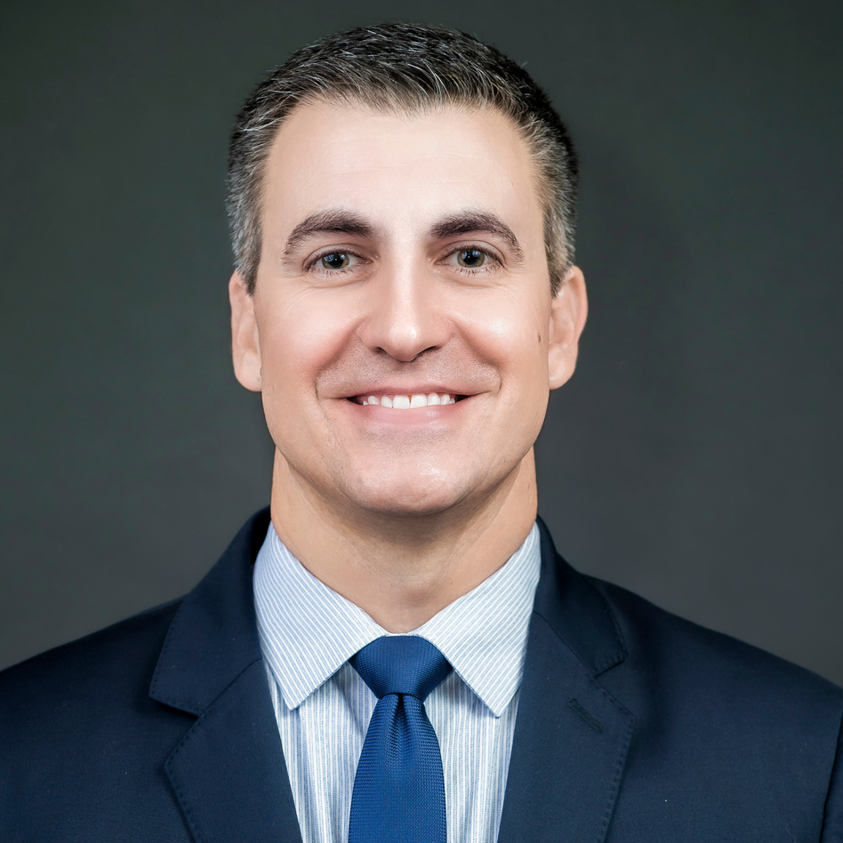
Social workers can make an impact in a variety of roles.
Ryan Speier, LMSW
Chief Operating Officer
With a highly diverse background of 20+ years in behavioral health operations, leadership, and management of physician services, Ryan delivers advanced, top-tier care in the day-to-day operations and multidisciplinary teams he leads at IPC.
Ryan oversees IPC’s operations, financial outcomes, and multi-state expansion strategy. Before joining IPC, he led a healthcare company with an operating budget of $45 million and more than 500 employees, increasing profitability and expanding services during his tenure.
In 2021, he was named one of Kansas City’s 40 Under 40 Executives by Ingram’s Magazine. Ryan also was nominated by the Kansas Legislature to the Kansas Mental Health Task Force and served as chair of the Kansas Hospital Association’s Behavioral Health Committee. Ryan’s passion is creating avenues that will open new opportunities to invest in comprehensive behavioral health, transforming communities nationwide.

Slide 11

About Our Group
  20+ years of experience
  Headquartered in Kansas City, Kansas
  Founded and led by psychiatrist Vishal Adma, M.D.
Over 70 psychiatrists, NPs, social workers, and other providers with diverse backgrounds
  95%+ retention rate for care providers
  Near 100% provider and staff satisfaction rate

Slide 12

Who We Serve
  Residential Programs
  Hospitals & Health Systems
  Inpatient Psychiatric Programs
  Outpatient/PHP/IOP Programs
  Community Mental Health Centers
  Federally Qualified Health Centers
  Universities and School Systems
Serving 40+ inpatient, outpatient, residential, and acute care settings
Care providers licensed in 30+ states; 68,000 encounters over the past year

Slide 13
Thank you!
Apply to join our team or learn more:
KRYSTAL SPEIER, LCPC
CLINICAL DIRECTOR
KSPEIER@RESPONSIVECENTERS.COM
SEEKING CLINICAL SOCIAL WORKERS
JACKIE DUFFY
VICE PRESIDENT, RECRUITMENT
JDUFFY@INTEGRATED-PC.COM
SEEKING CLINICAL SOCIAL WORKERS
AND MASTER SOCIAL WORKERS

